Slide 1
Heart Disease Prediction
Members:
Vidhi moteria 19BCE0525
Soham Faldu 19BCI0024

Slide 2
Introduction
In this pandemic situation, trying to help people recovering from any medical condition is the most important task for every human.
So, it’s our responsibility to use the knowledge we have to help them. So we decided to use different machine learning algorithms and see which will make the best prediction accuracy. By using this algorithm further we can help doctors warn the patient in advance to change their diets or increase medication.
As per our survey,
1.3 million died in 1990
2.8 million died in 2016
Assumption by Indian heart association: 23 million by 2030.

Slide 3
Algorithms Used
K-Nearest Neighbors
Support Vector Machine (Linear, rbf, sigmoid poly)
Decision Tree Classifier
Random Forest Algorithm
Neural Net Classifier

Slide 4
Design
DATASET and EXTERN LIBRARIES: We have used the ‘sklearn’ machine learning library along with ‘Keras’ with ‘TensorFlow’ as backend for all our computations.
Data source: Downloaded from Kaggle (.csv file).
IMPORTING THE DATASET AND UNDERSTANDING IT: we used read_csv() to read the dataset and save it to the dataset variable. Before any analysis, we just wanted to take a look at the data. So, we used the info () method.
Observation: There are a total of 13 features and 1 target variable. Also, there are no missing values so we don’t need to take care of any null values.

Slide 5
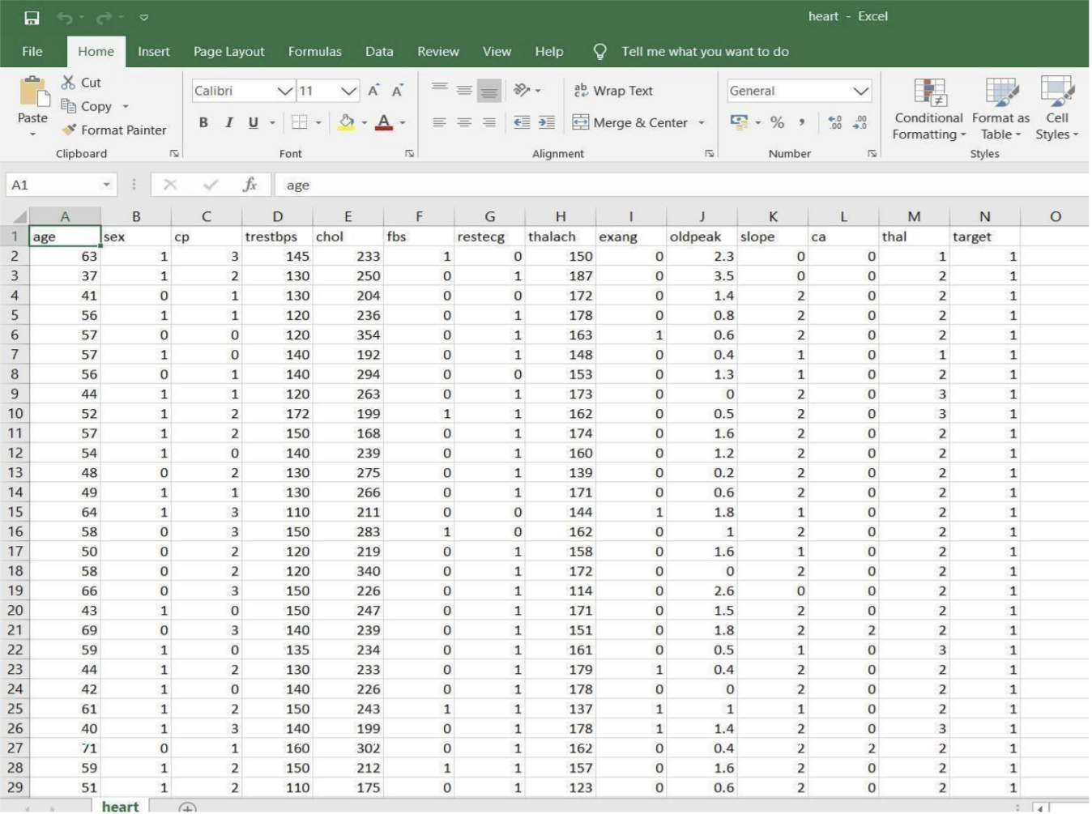
Dataset

Slide 6
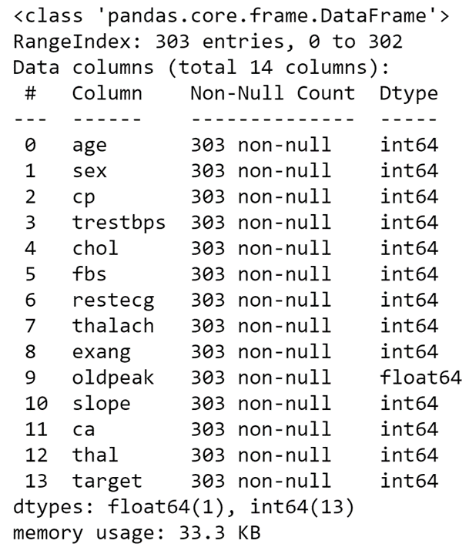
Info() method

Slide 7
Design
USE OF A CORRELATION MATRIX TO UNDERSTAND THE DATA
It’s easy to see if there is any single feature that has a very high correlation with our target value. Also, some of the features might have a negative correlation with the target value and some have positive.
It’s really essential that the dataset we are working on should be approximately balanced. An extremely imbalanced dataset can render the whole model training useless and thus, will be of no use.
For example we have a dataset of 100 people with 99 non-patients and 1 patient. Without even training and learning anything, the model can always say that any new person would be a non-patient and have an accuracy of 99%. However, as we are more interested in identifying the 1 person who is a patient, we need balanced datasets so that our model actually learns.

Slide 8
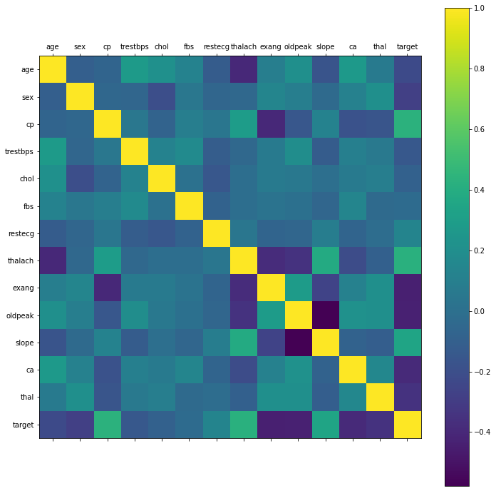
Correlation matrix

Slide 9
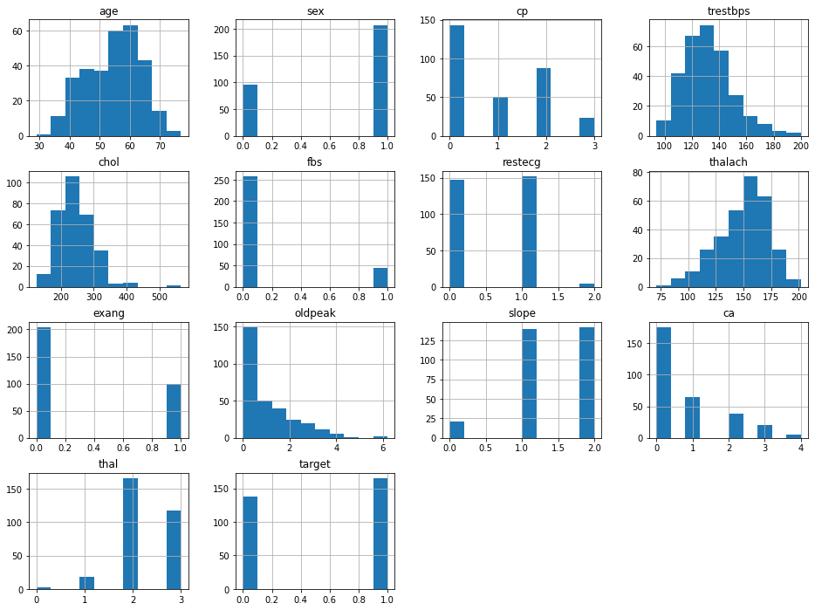
Understanding the Data

Slide 10
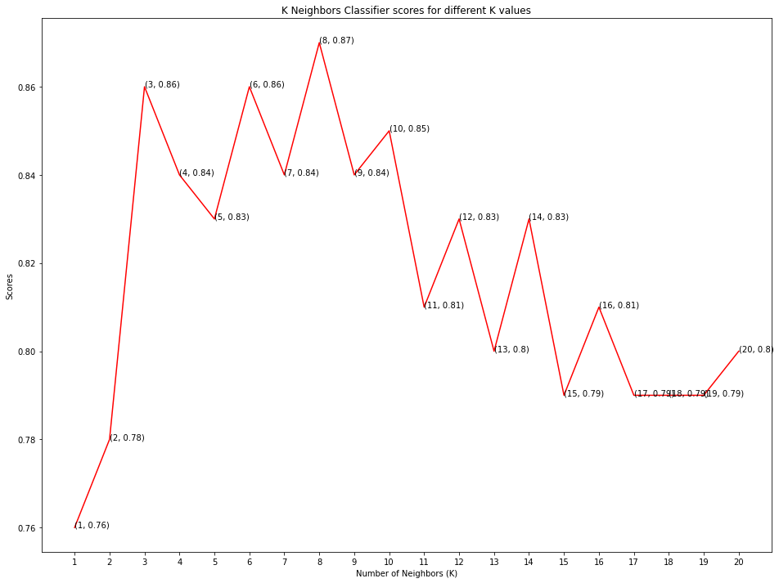
K – Nearest Neighbors
Highest score: 87% at k =8
K-Nearest Neighbors is one of the most basic yet essential classification algorithms in Machine Learning. It belongs to the supervised learning domain and finds intense application in pattern recognition, data mining and intrusion detection. In this the model structure determined from the dataset. This will be very helpful in practice where most of the real-world datasets do not follow mathematical theoretical assumptions.

Slide 11
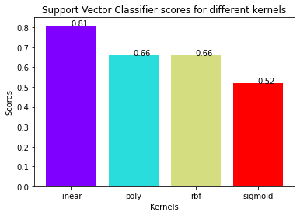
Support Vector Machine
Highest Score: 81% Kernel: Linear
Support Vector Machine” (SVM) is a supervised machine learning algorithm which can be used for both classification and regression challenges. However, it is mostly used in classification problems. In this algorithm, we plot each data item as a point in n-dimensional space (where n is number of features you have) with the value of each feature being the value of a particular coordinate. Then, we perform classification by finding the hyper-plane that differentiate the two classes very well.

Slide 12
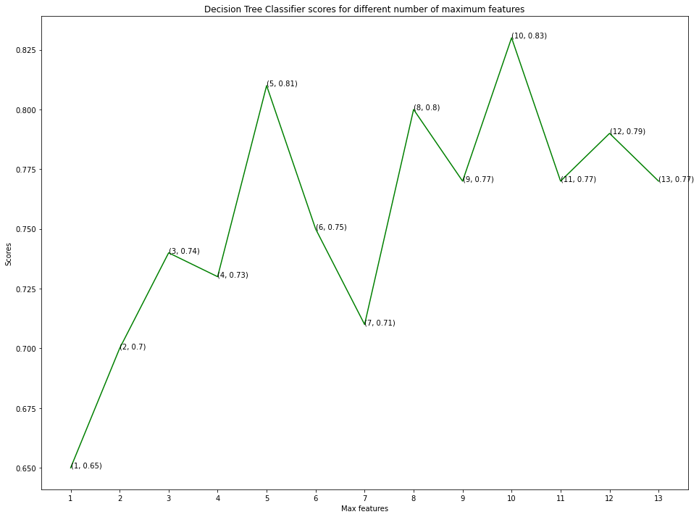
Decision Tree Classifier
Highest Score: 83% Features: 10
Decision tree is the most powerful and popular tool for classification and prediction. A Decision tree is a flowchart like tree structure, where each internal node denotes a test on an attribute, each branch represents an outcome of the test, and each leaf node (terminal node) holds a class label. This classifier creates a decision tree based on which, it assigns the class values to each data point. Here, we can vary the maximum number of features to be considered while creating the model.

Slide 13
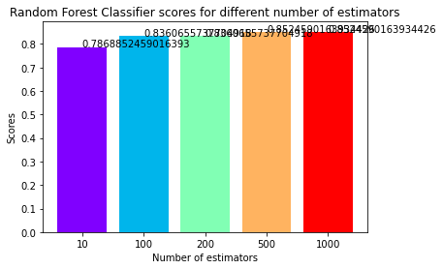
Random Forest Algorithm:
Highest Score: 85% Minimum Estimators: 500
Random forest is a supervised learning algorithm which is used for both classification as well as regression. But however, it is mainly used for classification problems. As we know that a forest is made up of trees and more trees means more robust forest. Similarly, random forest algorithm creates decision trees on data samples and then gets the prediction from each of them and finally selects the best solution by means of voting. It is an ensemble method which is better than a single decision tree because it reduces the over-fitting by averaging the result Random forest, like its name implies, consists of a large number of individual decision trees that operate as an ensemble. Each individual tree in the random forest spits out a class prediction and the class with the most votes becomes our model’s prediction.

Slide 14
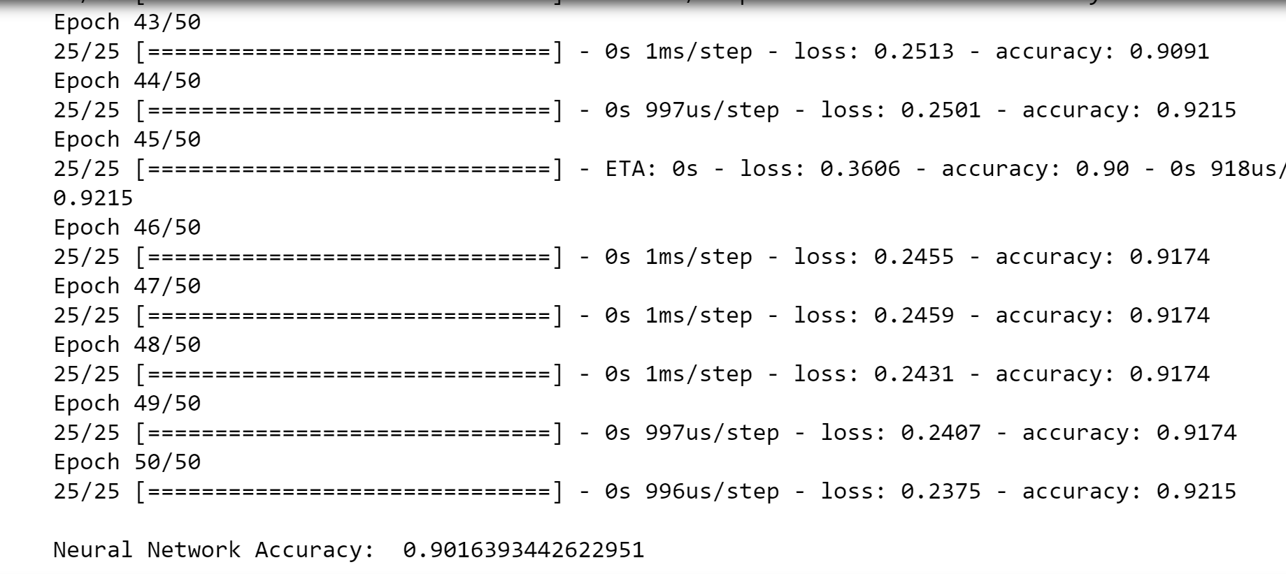
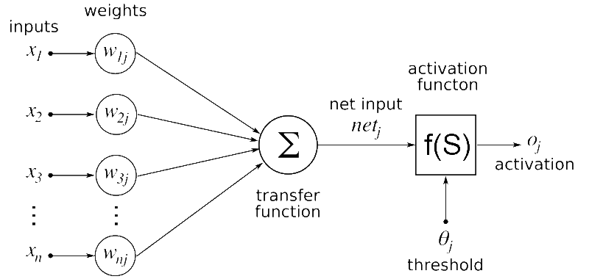
Neural Net Classifier
Accuracy: 90.16% Epochs: 50
Neural nets take inspiration from the learning process occurring in human brains. They consists of an artificial network of functions, called parameters, which allows the computer to learn, and to fine tune itself, by analyzing new data. Each parameter, sometimes also referred to as neurons, is a function which produces an output, after receiving one or multiple inputs. Those outputs are then passed to the next layer of neurons, which use them as inputs of their own function, and produce further outputs. Those outputs are then passed on to the next layer of neurons, and so it continues until every layer of neurons have been considered, and the terminal neurons have received their input. Those terminal neurons then output the final result for the model.

Slide 15
Results
Sr No. | Model Used | Description | Performance
1. | K – Neighbors Classifier | K = 8 | 87%
2. | Support vector Classifier | Linear Mode | 81%
3. | Decision Tree Classifier | Features = 10 | 83%
4. | Random Forest Tree | Estimators = 500 | 85%
5. | Neural Networks | 50 epochs & 2 hidden layers | 90%

Slide 16
Future Work
We can make a public website where we can launch this algorithm. So that the patients can check themselves by entering the 13 aspects. By doing this we can create a huge data base for our algorithm.

